Slide 1
Data Analysis of Walmart Store Sales
Vasanthi Pulusu

Slide 2
Introduction
Walmart Inc. is an American multinational retail corporation that operates a chain of hypermarkets, discount department stores, and grocery stores from the United States.
In this project we are going to use some of the store's data for forecasting using R-Programming.
Each store has various department, and in which we must predict department wise sales of the stores.

Slide 3





Objective
Load the data and pre-process it
Conducting exploratory data analysis on dataset.
Understanding the relationship between the features or predictors of the dataset.
Training the dataset for building a model
Working on the trained model using different machine learning techniques.

Slide 4
Dataset
In the project we are going to use four datasets.
stores.csv
This file contains anonymized information about the 45 stores, indicating the type and size of store.
2. train.csv
This is the historical training data, which covers to 2010-02-05 to 2012-11-01
Store - the store number
Dept - the department number
Date - the week
Weekly_Sales - sales for the given department in the given store
IsHoliday - whether the week is a special holiday week

Slide 5
Dataset (Continued)
3. test.csv
This file is identical to train.csv, except we have withheld the weekly sales. You must predict the sales for each triplet of store, department, and date in this file.
4.features.csv
This file contains additional data related to the store, department, and regional activity for the given dates. It contains the following fields:
Store - the store number
Date - the week
Temperature - average temperature in the region
Fuel_Price - cost of fuel in the region

Slide 6
Dataset (Continued)
MarkDown1-5 - anonymized data related to promotional markdowns that Walmart is running. MarkDown data is only available after Nov 2011, and is not available for all stores all the time. Any missing value is marked with an NA.
CPI - the consumer price index
Unemployment - the unemployment rate
IsHoliday - whether the week is a special holiday week

Slide 7
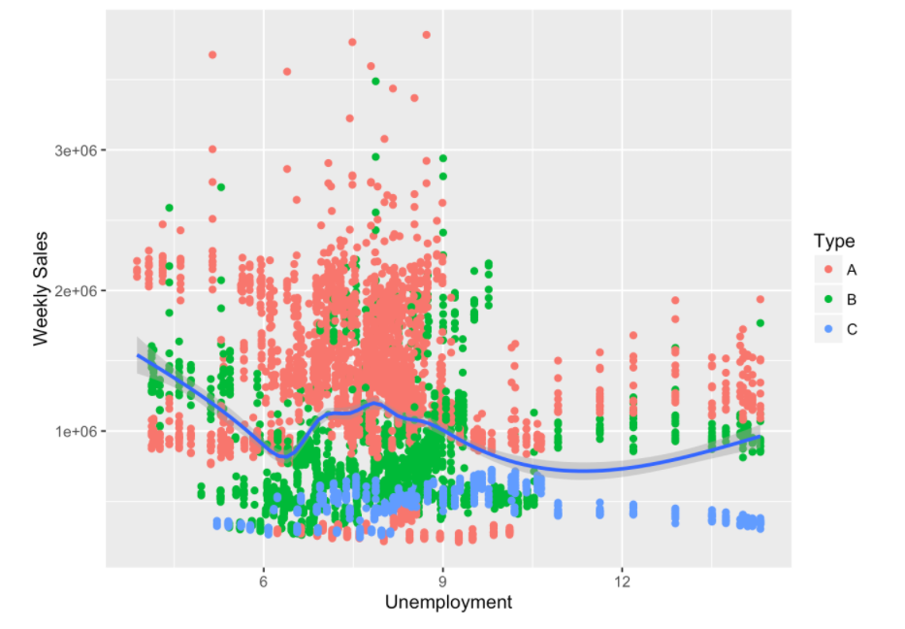
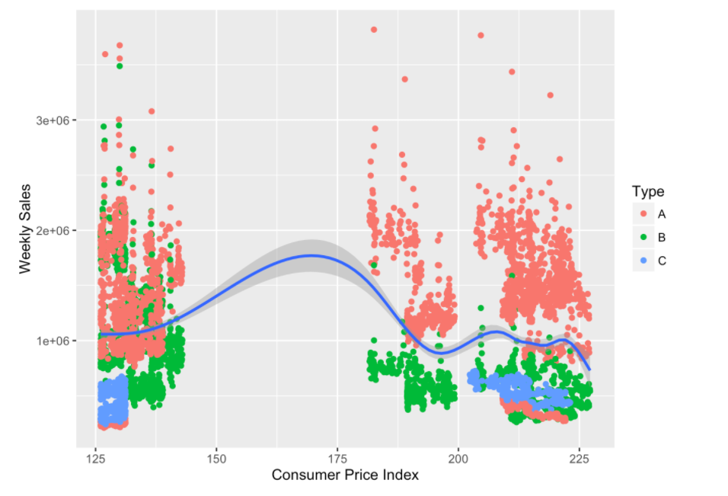
Exploratory Data Analysis

Slide 8
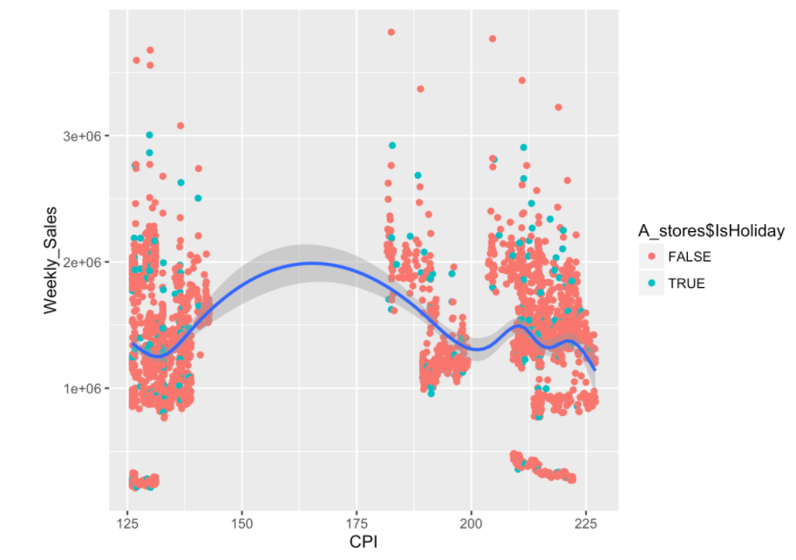
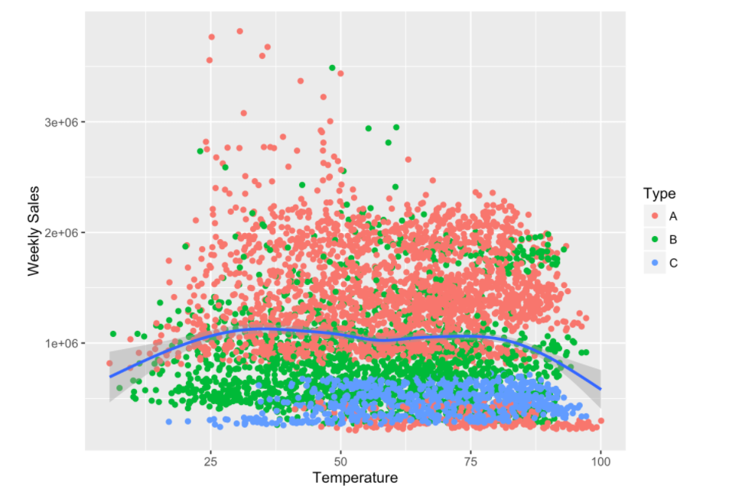
Exploratory Data Analysis

Slide 9
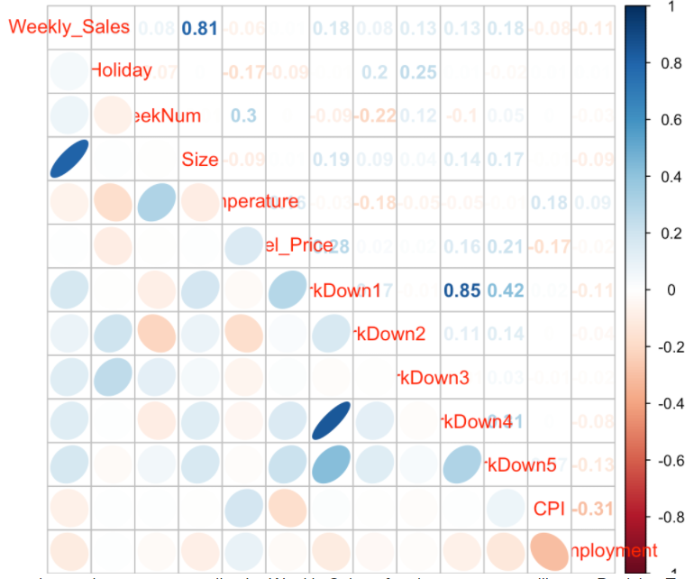
Correlation Matrix

Slide 10
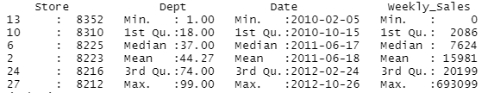
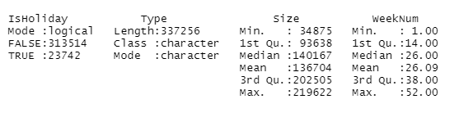
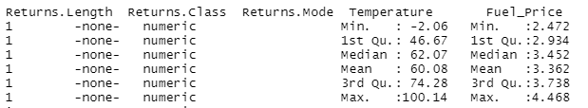
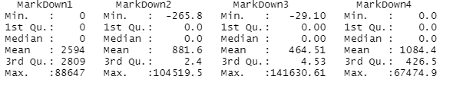
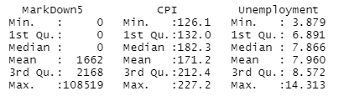
Summary of cleaned data

Slide 11
Machine Learning Models
Linear Regression
Decision Tree

Slide 12
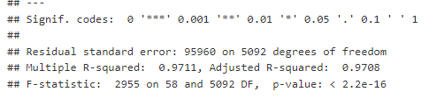
Linear Regression
R squared value = 0.97

Slide 13
Linear regression
We used CPI, Type and date as the response variables for predicting the weekly sales of the Walmart
The model accuracy is around 97%

Slide 14
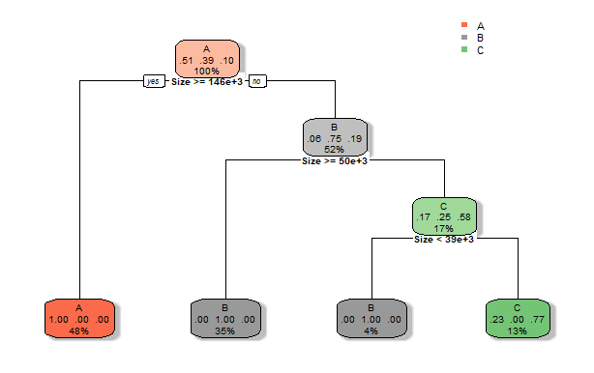
Decision Tree

Slide 15
Decision Tree
We pruned this model with a cp value of 0.0125
We used Type, Size features of the dataset as responsible variables for predicting the weekly sales of the Walmart.
The accuracy of the model is around 85%

Slide 16
Conclusion
We can say that regression model has the best accuracy and it is fit for this dataset compared to the decision tree
By this predictive modelling we can say that weekly sales of Walmart is dependent on the variables like CPI, type of store.

Slide 17
Thank You

